Slide 1

Motivation profile
Anna Berger
Generated on 1 October 2026
Notes:
{{notes01}}

Slide 2







Overview
Based on your selection, the TwentyFive analysis shows the following profile.
Entrepreneur
Motivation type
Entrepreneurs are positively motivated when they can be successful and have the freedom to realize their visions.
Essential basic needs:
- Enforcement
- (make progress)
Sustainable motivation:
- Achieve success
- Adventure
Favorable working conditions:
- Freedom of action
- Challenges
Expected strengths:
- Goal-oriented
- Fast implementation
Communication:
- Clear and distinct
- Visions
Learning behavior:
- visual
- try out
Motivation profile
<Foliennummer>
Notes:
A summary of the TwentyFive analysis for Anna Berger
{{notes02}}

Slide 3
Motivation type
Your motivation type is:
Entrepreneur
Top priority is given to the needs of:
- Enforcement
- (make progress)
Characteristics
Entrepreneurs are personalities who literally get things done. Whether they discover opportunities or are confronted with problems - they move things forward. They have visions and usually act intuitively. What they want to achieve should be meaningful. They like to be reflected by a friend or partner.
Goals
Asserting yourself, constantly scaling new peaks
Motivation profile
<Foliennummer>
Notes:
{{notes03}}

Slide 4
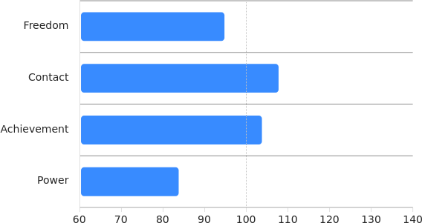
Driving forces (implicit motives)
Contact and performance: For this personality, the need for contact and performance are of above-average importance. Such people feel comfortable being able to achieve something special together with partners.
Freedom: going your own way unhindered and on your own responsibility.
Contact: ensure togetherness, empathize and coordinate.
Achievement: Learning, doing something special and being convincing.
Power: Having the lead in your hands and controlling the situation.
Motivation profile
<Foliennummer>
Notes:
Red = self-assertion: venture out and conquer the world. Pursue adventure. The will prevails. Develop yourself, assert yourself, acquire something new and grow. The "red" part of the inner team wants to achieve something and move forward, not get "stuck" somewhere. Typical characteristics: visionary and energetic.
Yellow = integration: Adapt and integrate yourself. You want to belong to a family, friends or a group and do something with them. The desire to make and maintain contacts. The "yellow" part of the inner team wants to belong, fit in and conform because no one can survive alone. Typical characteristics: lively and communicative.
Green = security: avoid risks, defend achievements and ensure their continuation. Preserve tradition and everything you consider important. Observe the world and retreat to a safe cave if necessary. Plan everything so that nothing goes wrong. The "green" part of the inner self wants to be sure of things and protect its existence. Typical characteristics: attentive and reliable.
Blue = Individuality: Develop into an independent individual who is valued for their uniqueness. Will compare and evaluate options. Provides high quality contribution based on own abilities. Wants feedback and recognition. Likes structure and personal responsibility. The "blue" part of the inner team wants to stand out from the crowd. Typical characteristics: hardworking and critical.
Black = knowledge: Understand the world through logic and rational thinking. Ask questions and find solutions. Wants information. Desire to learn and use the mind for rational thinking. The "black" part of the inner team strives to make decisions based on facts, evidence and logic. Typical characteristics: Rational perception and thoughtfulness.
White = Empathy: Strong understanding of self, others and the world. Perceives interactions and sees the consequences. Considers the feelings of others. Makes decisions based on gut instinct and intuition. Sense of aesthetics. Want to act responsibly. The "white" part of the inner team wants harmonious, rational behavior. Typical characteristics: intuitive and imaginative.

Slide 5
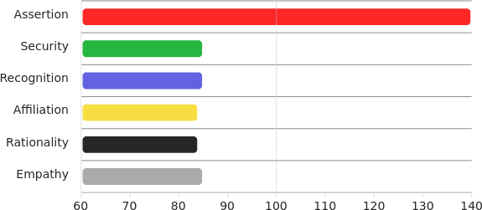






Basic needs
Our actions are determined by the satisfaction of our basic needs. Their deep, unconscious motivation is dominated by personality traits that strive for affiliation, empathy and assertion. As this has usually been the case since early childhood, natural competencies are formed.
Red = Assertion: getting ahead in life, daring adventure.
Green = Security: ensuring that risks are avoided and everything remains whole.
Blue = Recognition: strive critically for the best, be proud of yourself.
Yellow = Affiliation: Ensuring togetherness, adapting and belonging.
Black = Rationality: being curious, recognizing reality and meaning.
White = Empathy: Dealing with each other sensitively and responsibly.
Motivation profile
<Foliennummer>
Notes:
{{notes05}}

Slide 6
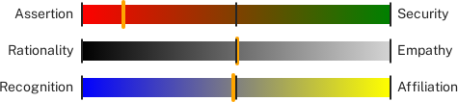
Natural conflicts need to be exploited
It's about balance, inner peace. We take both sides into account so that the opposing poles come into their own.
Red & green = planning: moving forward safely
White & black = reason: empathize and recognize what is at stake
Yellow & blue = coordination: adapt without giving up individual interests
„Height" dimension: Red wants to be successful and strives for the top. Green wants to keep its feet on the ground and avoid risks.
„Warmth" dimension: Black needs a cool, objective perception and white needs warm-hearted relationships.
„Proximity" dimension: Yellow seeks closeness to his friends. Blue wants to remain recognizable from a distance.
Motivation profile
<Foliennummer>
Notes:
{{notes06}}

Slide 7
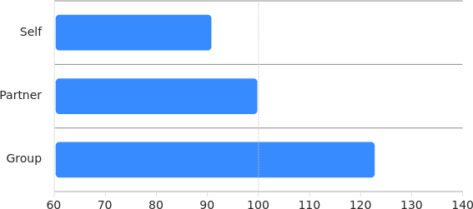
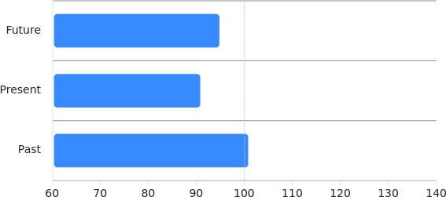
Social and temporal orientation
Self: How are my concerns affected by the situation?
Partner: What could affect my partner positively or negatively?
Group: What significance does the situation have for family or friends?
Future: How should I act with regard to my goals?
Present: What current influences should I take into account?
Past: What experiences can I use today?
Motivation profile
<Foliennummer>
Notes:
{{notes07}}

Slide 8
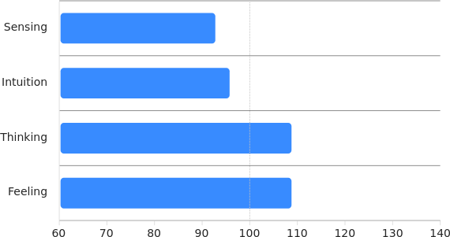
Preferences
Intuition: The assessment of a situation is primarily based on intuition.
Thinking: Rational and logical thinking plays a key role in the decisions that have to be made.
How do we become aware of something?
Sensing: We use our senses to accurately grasp reality.
Intuition: Complex reality as a whole can usually only be assessed intuitively.
How do we make our decisions?
Thinking: Decisions are about meaningful goals and logical connections.
Feeling: A good gut feeling ensures that the planned decision is the right one.
Motivation profile
<Foliennummer>
Notes:
{{notes08}}

Slide 9
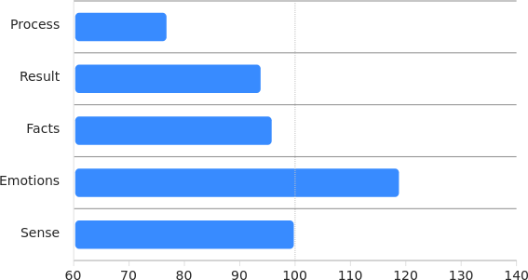
Focusing
Result: When working on longer-term projects, there is a stronger focus on the result.
Emotions: When assessing changes and opportunities, questions about the emotional impact are decisive.
Process: Perceiving the processes in order to be able to intervene.
Result: Consciously focus on what you ultimately want to achieve.
Facts: The tangible facts control perception and decision-making.
Emotions: It is important to consciously take care of the emotional effects.
Sense: It's about personal values: 'Why is it important to do or not to do something?
Motivation profile
<Foliennummer>
Notes:
{{notes09}}

Slide 10
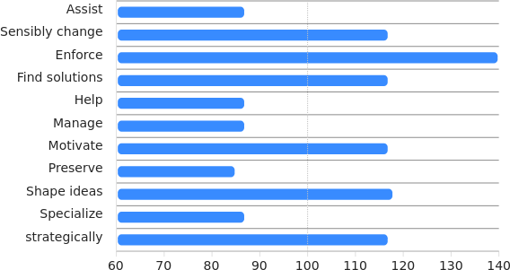
Competencies: Change and preservation
Shaping the future
Due to the basic needs, orientations and personal preferences described above, these skills are at the forefront when it comes to the questions of what should be retained and what should change:
Enforce: This competence can be realized in various ways, for example through the power of arguments or perseverance.
Design ideas: To ensure that our ideas are understood and shared, we provide an attractive design.
Find solutions: It's about the ability to solve difficult problems. We find enough of these in everyday life.
Motivation profile
<Foliennummer>

Slide 11
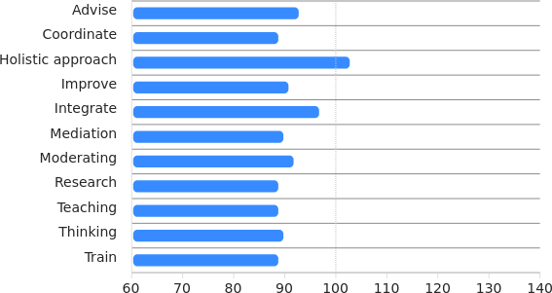
Competencies: Well-being and success
Get involved
We feel comfortable and work more successfully for the benefit of everyone involved when we contribute our special skills.
Holistic approach: try to perceive all aspects and ensure balance.
Integrate: coordinate ourselves and our partners to enable us to act together.
Advised: Our emotional experiences give other people new perspectives.
Motivation profile
<Foliennummer>

Slide 12
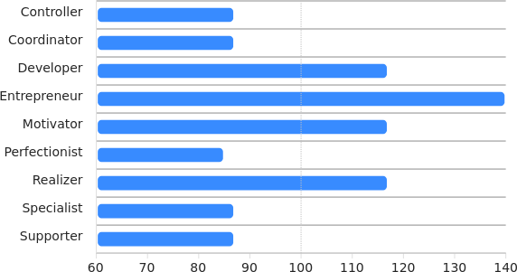
The right team roles
Support the team
As a team, we take on different roles that should match our skills as closely as possible.
Entrepreneur (doer): want to achieve their goals with energy and inventiveness. They realize what they have set out to do.
Developer (innovator): like unresolved problems, because then they can contribute innovative services to the success of the team.
Realizer (implementer): make the team's ideas work. They develop well thought-out strategies and implement them powerfully in practice.
Motivation profile
<Foliennummer>

Slide 13
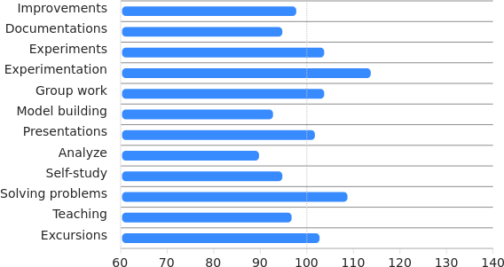
The individual way of learning
Learning in your own way
Depending on our personality, we develop certain learning strategies from an early age that suit what is important to us.
Try it out: This type of learning requires courage and the realization that we can accept failure and learn from it.
Solve problems yourself: They can be complex tasks. They provoke thinking and a wealth of ideas.
Group work: In our joint work and discussions, we supplement our knowledge with the views and opinions of our partners.
Motivation profile
<Foliennummer>

Slide 14
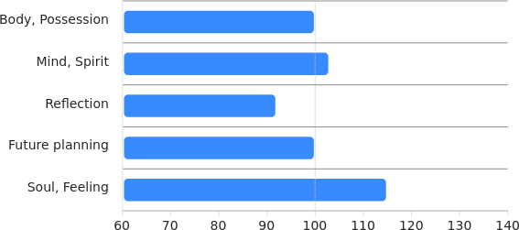
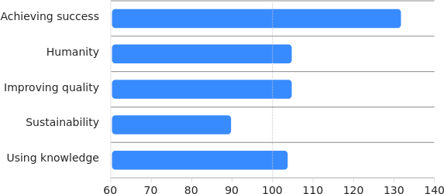
Professional relationships: Values and goals
Why do we work together?
Soul, feelings: Emotions are the best guide when it comes to judging our actions.
Spirit, sense, culture: What we do should also make sense from a human perspective.
What are important topics for me?
Achieve success: I also want to realize what I consider important in our work together.
Qualitative improvement: Whether it's about relationships or the things we use, it makes sense to always strive for optimization.
Motivation profile
<Foliennummer>

Slide 15
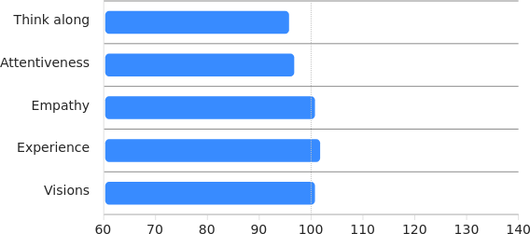
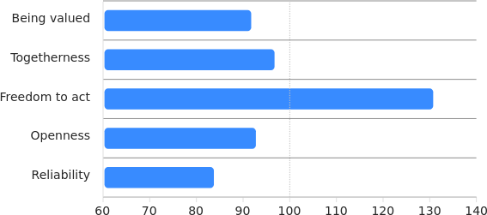
Personal relationships: mutual support
What do I give my partners?
We humans are different. This has the advantage that we can support each other.
Experience: I let my partners share what I have learned in life.
Empathy: I can feel whether and how I can support my partner.
What do I need?
Our partners also feel good when they can help us with our projects.
Freedom of action: I have my own tasks and can do something that is important to me.
Togetherness, closeness: The 'we-feeling' is important to me. I need personal closeness for that.
Motivation profile
<Foliennummer>

Slide 16
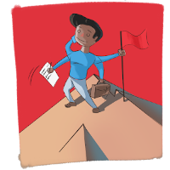
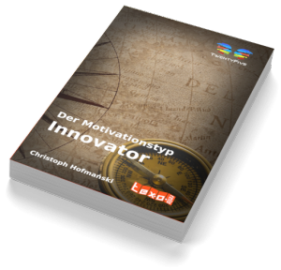
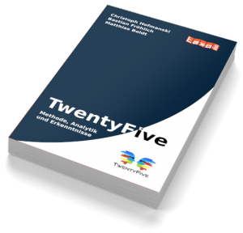
Further additions
The TwentyFive type Entrepreneur
Further information on this type of motivation can be found in the knowledge base:
https://doc.senseaition.com/en/twentyfive/portraits/01_unternehmer/
https://doc.senseaition.com/en/kommunikation/unternehmer/
A lot of general and further information can also be found there:
https://doc.senseaition.com/twentyfive/
For the motivation type Entrepreneur there is a book with many further tips:
"The motivation type Entrepreneur"
https://texorello.org/de/W44C0P0
There is a book to deepen your understanding of the TwentyFive method:
"TwentyFive - On the powers of the unconscious"
https://texorello.org/en/W33C0P0
Motivation profile
<Foliennummer>
Notes:
{{notes16}}

Slide 17
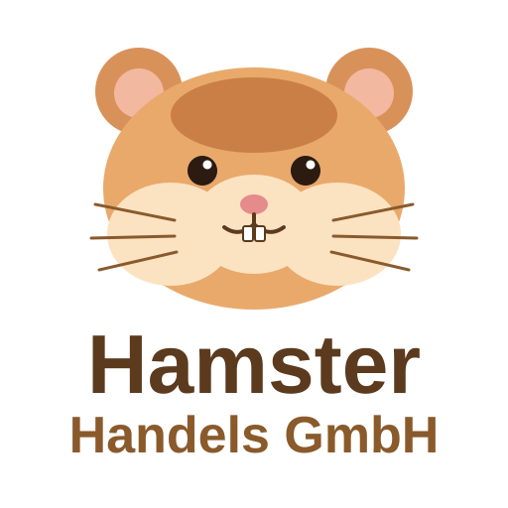

sense.AI.tion
For further information, please contact:
Hamster Handels GmbH
Generated with MatchLytics by:
sense.AI.tion GmbH
Schmiedestraße 2a
15745 Wildau
Germany
https://senseaition.com/
Motivation profile
<Foliennummer>
Notes:
{{notes17}}

