Slide 1

Comparison of motivation profiles
Anna Berger | Ben Keller
Generated on 2 October 2026

Slide 2

Introduction
There is always an opposite side to every need and every orientation
For example, if we are drawn to red by 120 points and to green by 80 points, the red energy is 40 points stronger. This means we are more likely to overlook potential risks.
Diversity is needed in partnerships and in teams. The more we differ, the better we complement each other with our different skills. We can coordinate well with each other if we use one of the characteristics in which we are similar, perhaps in our orientation or our decision-making behavior.
The following tips relate to teamwork.
Anna Berger | Ben Keller
<Foliennummer>
Notes:
Red = enforcement:
Going out into the world. Going on adventures. Asserting your will. Developing yourself, asserting yourself, daring to do something and acquiring something new. The "red" side of the inner team wants to achieve something and make progress so as not to get "stuck" somewhere. Motivation to act spontaneously with the typical characteristics: visionary and energetic.

Slide 3
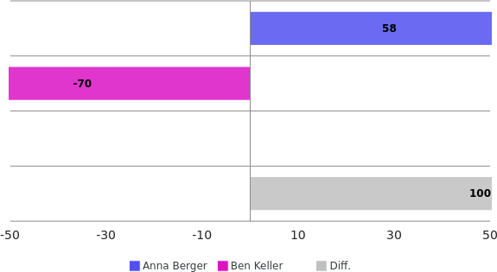
Red-Green
Balance: Reliable actions
Security
Ensuring order
Avoid risks
Enforcement
Getting ahead
Strive for success
Anna Berger: very assertiveness-oriented
Ben Keller: very security-oriented
Anna Berger strives for significantly more success and change.
Synergy: Use security for planning and assertiveness for implementation.
Anna Berger | Ben Keller
<Foliennummer>
Notes:
Red = enforcement:
Going out into the world. Going on adventures. Asserting your will. Developing yourself, asserting yourself, daring to do something and acquiring something new. The "red" side of the inner team wants to achieve something and make progress so as not to get "stuck" somewhere. Motivation to act spontaneously with the typical characteristics: visionary and energetic.

Slide 4
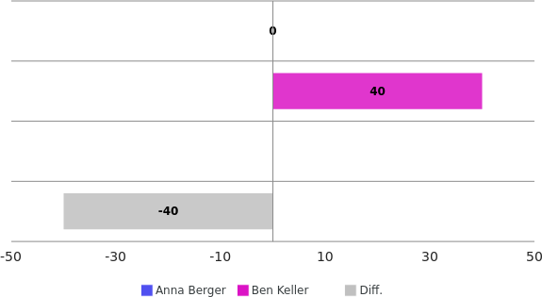
Blue-yellow
Balance: distribution of tasks, coordination
Recognition
Ensuring quality
Individuality
Affiliation
Adapt
Communication
Anna Berger: balanced
Ben Keller: very belonging-oriented
Anna Berger will provide much stronger specialization.
Synergy: Use specialization for quality and belonging for communication.
Anna Berger | Ben Keller
<Foliennummer>
Notes:
Red = enforcement:
Going out into the world. Going on adventures. Asserting your will. Developing yourself, asserting yourself, daring to do something and acquiring something new. The "red" side of the inner team wants to achieve something and make progress so as not to get "stuck" somewhere. Motivation to act spontaneously with the typical characteristics: visionary and energetic.

Slide 5
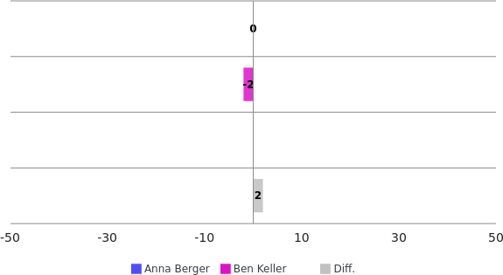
Empathy vs. insight
Balance: emotional intelligence
Empathy
Empathize
Emotionality
Insight
Recognize reality
Rationality
Anna Berger: balanced
Ben Keller: balanced
Both profiles set similar priorities
Recommendation: Weigh meaningful and responsible actions together.
Anna Berger | Ben Keller
<Foliennummer>
Notes:
Red = enforcement:
Going out into the world. Going on adventures. Asserting your will. Developing yourself, asserting yourself, daring to do something and acquiring something new. The "red" side of the inner team wants to achieve something and make progress so as not to get "stuck" somewhere. Motivation to act spontaneously with the typical characteristics: visionary and energetic.

Slide 6
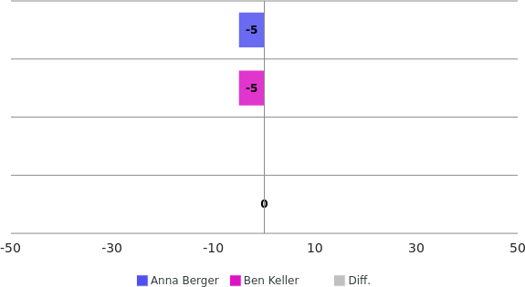
Future vs. past
Balance: actively using experience
The past
Experience
Continuity
The future
Planning
Visions
Anna Berger: balanced
Ben Keller: balanced
Both profiles set similar priorities.
Recommendation: Review planning based on past experiences.
Anna Berger | Ben Keller
<Foliennummer>
Notes:
Red = enforcement:
Going out into the world. Going on adventures. Asserting your will. Developing yourself, asserting yourself, daring to do something and acquiring something new. The "red" side of the inner team wants to achieve something and make progress so as not to get "stuck" somewhere. Motivation to act spontaneously with the typical characteristics: visionary and energetic.

Slide 7
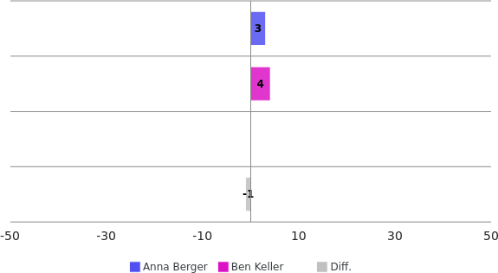
Facts vs. sense
Balance: sensible design
Facts
Measurability
How questions
Sense
Ideas + Culture
Why questions
Anna Berger: balanced
Ben Keller: balanced
Both profiles assume similar contexts.
Recommendation: Agree on meaningful results based on facts.
Anna Berger | Ben Keller
<Foliennummer>
Notes:
Red = enforcement:
Going out into the world. Going on adventures. Asserting your will. Developing yourself, asserting yourself, daring to do something and acquiring something new. The "red" side of the inner team wants to achieve something and make progress so as not to get "stuck" somewhere. Motivation to act spontaneously with the typical characteristics: visionary and energetic.

Slide 8
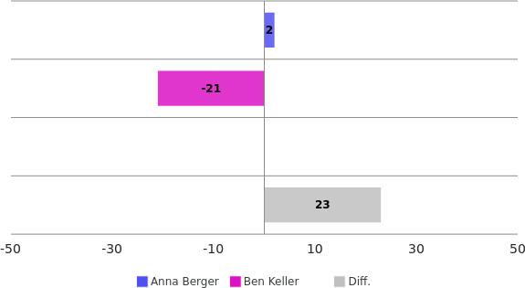
Perception: Sensing vs. intuition
Balance: reflected ideas
Sensing
rational
Detailed perception
Intuition
complex, holistic
Perception
Anna Berger: balanced
Ben Keller: significant focus on details
Anna Berger utilizes intuition significantly more.
Synergy: Discuss and analyze ideas together (brainstorming).
Anna Berger | Ben Keller
<Foliennummer>
Notes:
Red = enforcement:
Going out into the world. Going on adventures. Asserting your will. Developing yourself, asserting yourself, daring to do something and acquiring something new. The "red" side of the inner team wants to achieve something and make progress so as not to get "stuck" somewhere. Motivation to act spontaneously with the typical characteristics: visionary and energetic.

Slide 9
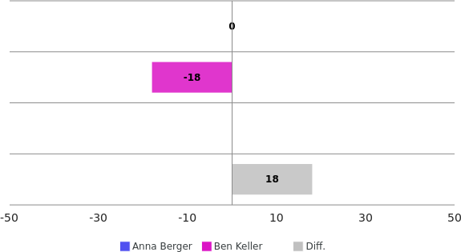
Decision: Feeling vs. thinking
Balance: sensible considerations
Feeling
Decisions with a good feeling
Thinking
Well thought-out decisions
Anna Berger: balanced
Ben Keller: will pay somewhat more attention to feeling
Anna Berger utilizes somewhat more reason.
Tip: Discuss the reasons for thinking and feeling before important decisions.
Anna Berger | Ben Keller
<Foliennummer>
Notes:
Red = enforcement:
Going out into the world. Going on adventures. Asserting your will. Developing yourself, asserting yourself, daring to do something and acquiring something new. The "red" side of the inner team wants to achieve something and make progress so as not to get "stuck" somewhere. Motivation to act spontaneously with the typical characteristics: visionary and energetic.

Slide 10
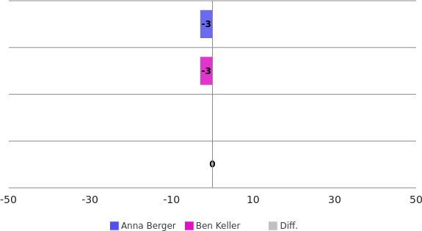
Drive to act: Impulsiveness vs. self-control
Balance: Self-confidence
Self-control
Slow thinking
thoughtful, reflective
Impulsiveness
Quick thinking
spontaneous, authentic
Anna Berger: balanced
Ben Keller: balanced
Both profiles act similarly spontaneously.
Recommendation: Agree on in which situations spontaneous or controlled actions should take place.
Anna Berger | Ben Keller
<Foliennummer>
Notes:
Red = enforcement:
Going out into the world. Going on adventures. Asserting your will. Developing yourself, asserting yourself, daring to do something and acquiring something new. The "red" side of the inner team wants to achieve something and make progress so as not to get "stuck" somewhere. Motivation to act spontaneously with the typical characteristics: visionary and energetic.

Slide 11
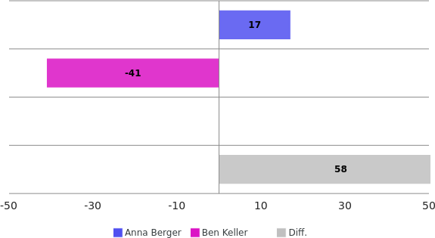
Action control: process vs. result
Balance: appropriate reactions
Process
Situation perception
Target/actual deviations
Result
Target focus
Perception of opportunities
Anna Berger: somewhat more goal-oriented
Ben Keller: significantly stronger focus on the process
Anna Berger focuses much more on the desired results.
Synergy: For wise action, discuss processes and their expected consequences.
Anna Berger | Ben Keller
<Foliennummer>
Notes:
Red = enforcement:
Going out into the world. Going on adventures. Asserting your will. Developing yourself, asserting yourself, daring to do something and acquiring something new. The "red" side of the inner team wants to achieve something and make progress so as not to get "stuck" somewhere. Motivation to act spontaneously with the typical characteristics: visionary and energetic.

Slide 12


sense.AI.tion
For further information, please contact:
Hamster Handels GmbH
Generated with MatchLytics by:
sense.AI.tion GmbH
Schmiedestraße 2a
15745 Wildau
Germany
https://senseaition.com/
Anna Berger | Ben Keller
<Foliennummer>
Notes:
{{notes17}}

