Slide 1

Team motivation profile
Vertrieb Nord
Generated on 2 October 2026

Slide 2

Team members and competencies
 | Investigate | Supervise | Coordinate | Handle | Assist | Analyse | Construct | Execute | Model | Invent | Consult | Sell | Align | Motivate | Support
Greta Lorenz | 86 | 86 | 86 | 86 | 85 | 86 | 86 | 86 | 111 | 86 | 107 | 98 | 104 | 86 | 85
Ines Kraft | 99 | 108 | 95 | 108 | 102 | 104 | 98 | 102 | 89 | 87 | 98 | 94 | 96 | 87 | 104
Anna Berger | 102 | 85 | 84 | 85 | 85 | 84 | 105 | 114 | 116 | 116 | 85 | 100 | 85 | 116 | 85
Elif Yilmaz | 89 | 88 | 114 | 88 | 120 | 89 | 89 | 89 | 88 | 89 | 107 | 109 | 115 | 120 | 117
Felix Brandt | 102 | 101 | 105 | 100 | 88 | 107 | 101 | 88 | 88 | 108 | 88 | 88 | 88 | 88 | 88
Hannes Roth | 110 | 99 | 102 | 99 | 89 | 104 | 111 | 107 | 106 | 121 | 89 | 98 | 90 | 107 | 89
Ben Keller | 81 | 106 | 104 | 105 | 127 | 92 | 80 | 76 | 76 | 70 | 116 | 96 | 109 | 89 | 127
Clara Vogt | 106 | 104 | 105 | 105 | 90 | 114 | 105 | 101 | 89 | 100 | 90 | 95 | 97 | 89 | 90
David Nowak | 100 | 90 | 93 | 90 | 91 | 91 | 101 | 104 | 120 | 108 | 103 | 105 | 101 | 108 | 91
Team motivation profile
<Foliennummer>
Notes:
The table shows the different strengths that everyone brings to the team based on their personality.

Slide 3
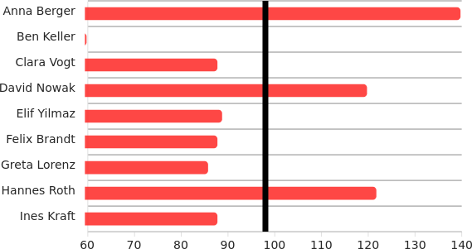
Basic need for enforcement
With values lower than the team average:
The more the individual team members are drawn in this direction, the greater their stabilizing influence.
With values greater than the team average:
These team members strive for positive change more than the majority of their colleagues.
Overall, the team has an average drive for assertiveness. It needs common goals to achieve something positive.
Cooperation between the different characters provides the opportunity for well-planned and secure developments.
Team motivation profile
<Foliennummer>
Notes:
Red = enforcement:
Going out into the world. Going on adventures. Asserting your will. Developing yourself, asserting yourself, daring to do something and acquiring something new. The "red" side of the inner team wants to achieve something and make progress so as not to get "stuck" somewhere. Motivation to act spontaneously with the typical characteristics: visionary and energetic.

Slide 4
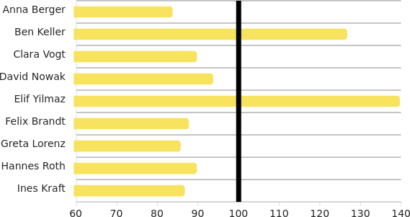
Basic need for belonging
With values lower than the team average:
For these team members, adapting to their environment and communication are less important.
With values greater than the team average:
These team members strive more for integration. They like to communicate and can represent the team.
The need for belonging is moderately pronounced within the team. Coordination on common topics is important for integrating colleagues.
Team members with similar needs find it easier to coordinate and reach a consensus.
Team motivation profile
<Foliennummer>
Notes:
Yellow = belonging (integration):
Adapt and integrate. Belonging to the family, the circle of friends, the clique or the company and orienting yourself towards the community. The "yellow" side gets involved, joins in and integrates - because no one can live alone from an early age. Motivation to make and maintain contacts with the typical characteristics: lively and communicative.

Slide 5
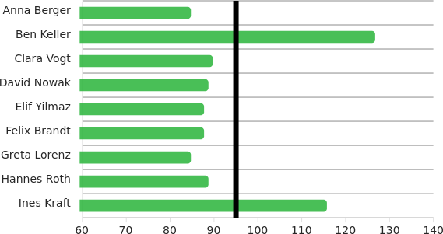
Basic need for security
With values lower than the team average:
For these team members, stability and continuity are less important than flexibility, for example.
With values greater than the team average:
For these team members, it is more important to avoid risks. They value preservation and consistency.
Overall, the team has an average drive for security and continuity. It needs common rules to act properly.
Cooperation between the different characters provides the opportunity to recognize risks and react appropriately.
Team motivation profile
<Foliennummer>
Notes:
Green = safety:
Preserve health and life. Avoid risks, defend what you have achieved, control events and yourself. Retreat to a safe cave when necessary. The "green" side wants to secure physical and mental existence in the long term. Motivation to preserve with the typical characteristics: attentive and reliable.

Slide 6
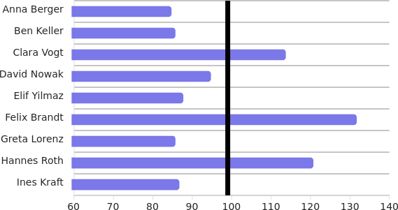
Basic need for recognition
With values lower than the team average:
For these team members, personal recognition and quality awareness are less pronounced.
With values greater than the team average:
Quality, conscientiousness and positive feedback are important to these team members.
The need for specialization is moderately pronounced within the team. Most colleagues are focused on performing their own work with good professional quality.
Team members with similar needs find it easier to accept each other and give each other the necessary feedback.
Team motivation profile
<Foliennummer>
Notes:
Blue = recognition (individuality):
Be perceived positively as an individual. Avoid mistakes. Be true to yourself, remain authentic. The "blue" part of motivation wants to be recognized as an independent person and not get lost in the crowd. Motivation for optimization with the typical characteristics: conscientious and critical.

Slide 7
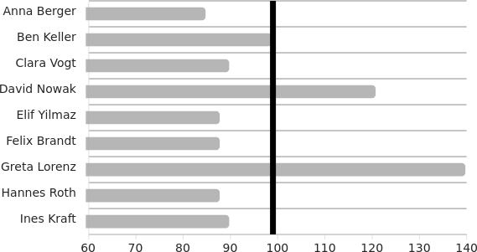
Basic need for empathy
With values lower than the team average:
The need to empathize with the concerns of those involved or affected is less active.
With values greater than the team average:
These team members use their empathy to perceive holistically.
Overall, the team has an average drive for empathy. Besides rational rules, it needs time and openness to feel comfortable within the team.
Team members with similarly strong needs find it easier to trust each other and develop a good feeling for each other.
Team motivation profile
<Foliennummer>
Notes:
White = empathy:
To have an unerring sense of oneself and the world. To be able to understand and anticipate the inner and outer complexity in its causes, interactions and meanings. The "white" side urges harmonious, appropriate behavior. Motivation for holistic perception with the typical characteristics: Intuition and imagination.

Slide 8
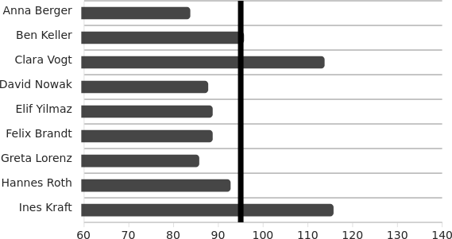
Basic need for knowledge
With values lower than the team average:
The search for rational knowledge is less pronounced among these team members.
With values greater than the team average:
For these team members, research, analysis and logical conclusions are more important.
The need for insight is moderately pronounced within the team. Most colleagues are focused on performing their work based on rational considerations.
When both sides work together, there is an opportunity to recognize the soft, more emotional factors that influence our thoughts and feelings.
Team motivation profile
<Foliennummer>
Notes:
Black = knowledge:
To recognize the structures and connections in order to understand the reality of the world. To create knowledge, using the mind to penetrate further or to look at things from a different perspective. The "black" part strives for correct decisions. Motivation to learn with the typical characteristics: rational perception and thinking.

Slide 9
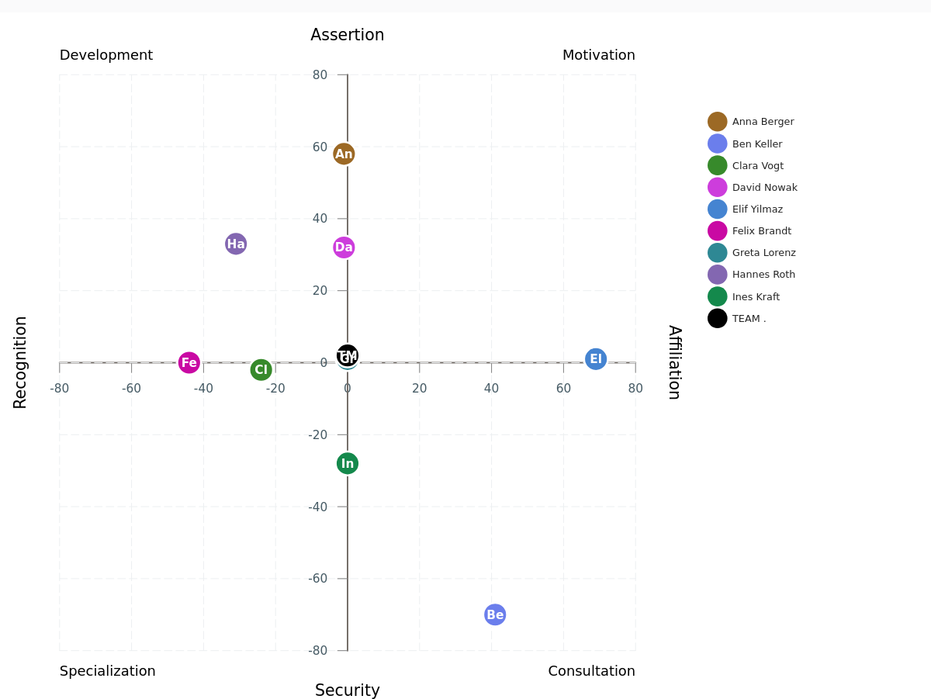
The dynamics in the team
Team motivation profile
<Foliennummer>
Notes:
Top right = motivation: asserting yourself together with the team. These people feel good when they can positively influence others around them: We want to achieve something together.
Bottom-right = Counseling: Belonging and security are important to team members in this quadrant. They like tasks with which they can help other people. They are typical service providers.
Bottom-left = specialization: Security and recognition motivate personalities in this field. They impress with their quality awareness and their love of order. They are the reliable specialists in the team.
Top-left = development: We are recognized for special achievements and can assert ourselves as a team with innovative ideas. This is where we find researchers, explorers and adventurers.
Center = Management: All profiles in the center are influenced by the desire for balance. They strive for action and decisions that meet all needs.

Slide 10
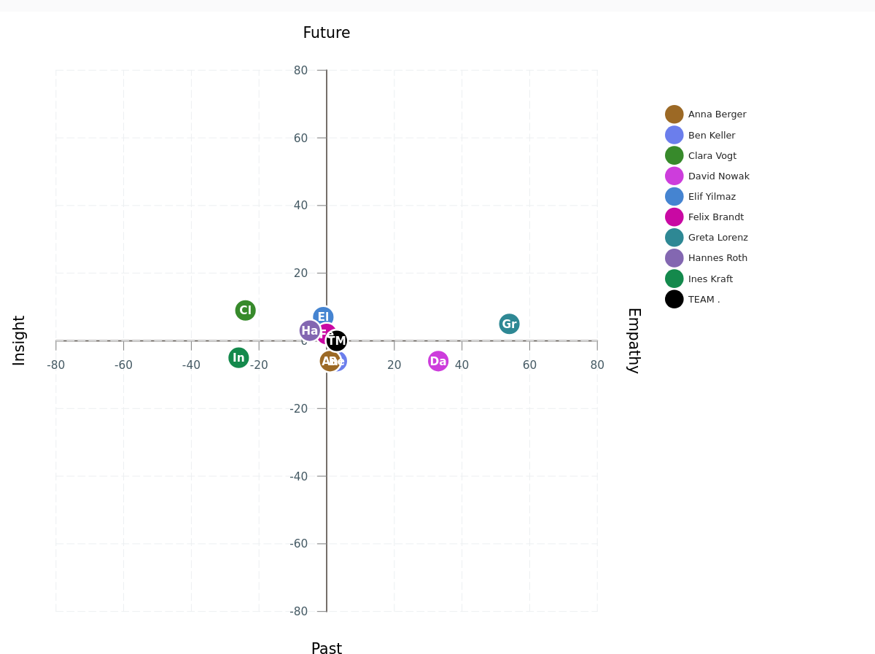
Orientation in the evaluation of situations
Team motivation profile
<Foliennummer>
Notes:
Top right = attractive image of the future: In this quadrant, we empathize with what the future could bring. We want to shape a positive future.
Bottom right = positive experiences: Those who are guided by empathic perception of the past take the best memories as a pattern for evaluating situations and opportunities.
Below-left = grown know-how: If we analyze and evaluate experience rationally, the logical insights that we can use today grow.
Top-left = well thought-out strategies: The insight side ensures well-defined goals. If we know where we stand today, we can recognize and evaluate the feasible paths.
Center = Holism: Experience and vision, rationality and emotions all lead to the same position. The team as a whole should do justice to this.

Slide 11
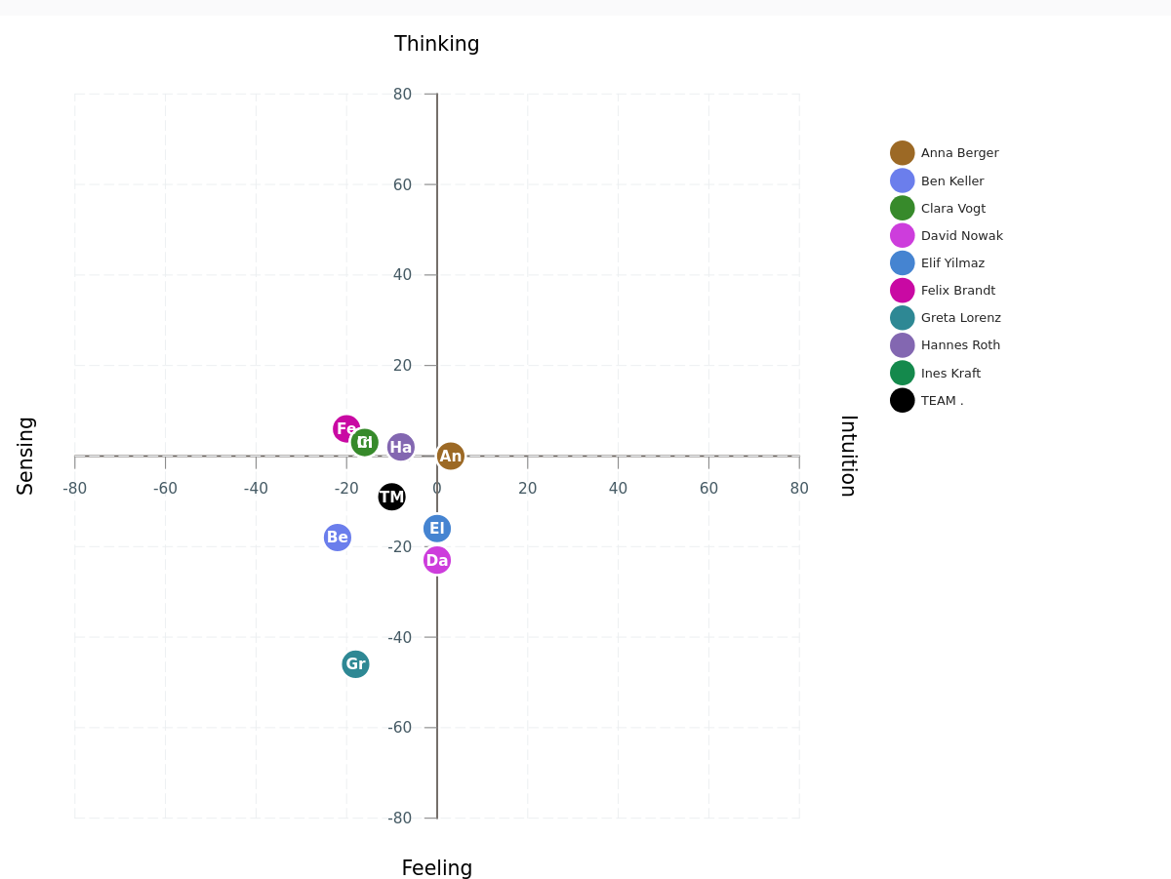
Preferences: Perceiving and deciding
Team motivation profile
<Foliennummer>
Notes:
Top right = Thinking through ideas: Intuition reflects on the situation and provides ideas for action, which we think through and logically evaluate in the next step of the decision-making process.
Bottom-right = having a feeling for the best solution: Reality is often too complex to evaluate intuitive ideas. When there are many uncertainties, we tend to trust our gut feeling.
Below-left = sensing the meanings: When we perceive reality with all our senses (sensing), we can sense (feeling) the opportunities and risks it presents.
Top-left = thinking through the facts: Detailed perception via all the senses provides the information we need to make a well-considered decision. This rational strategy is used by team members in this field.
Center = balanced decisions: Sensing and intuition show us reality, feeling and thinking give us the decisive ideas and assessments. The team as a whole should ensure this balance.

Slide 12
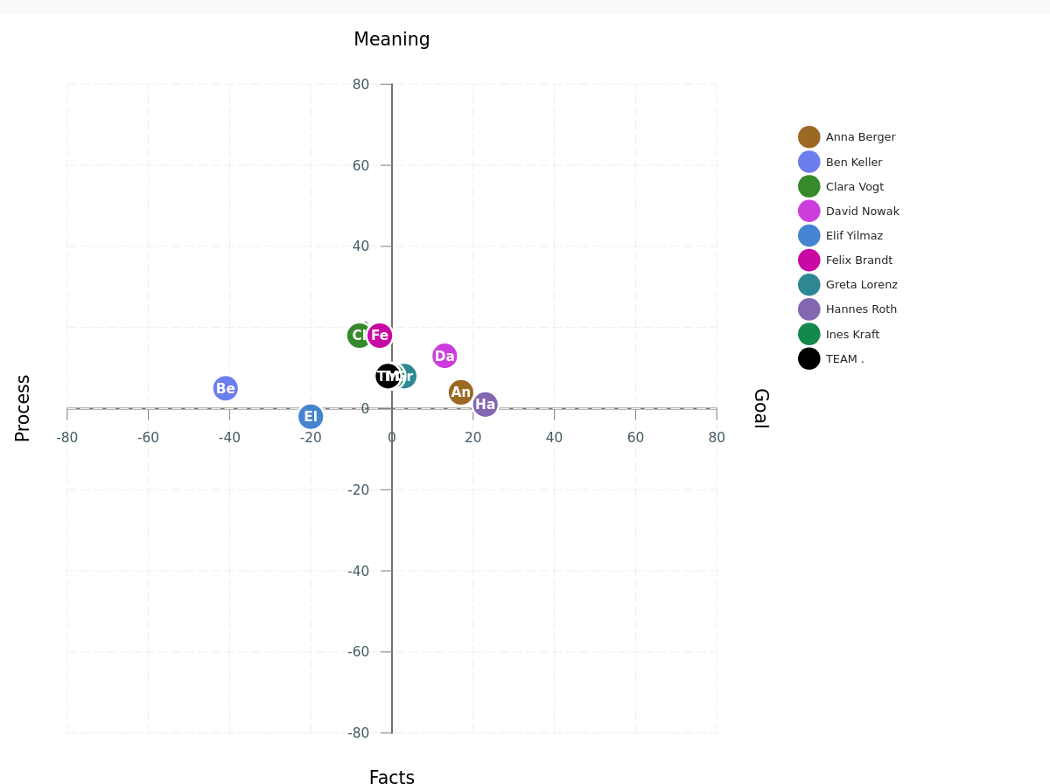
Focusing on the completion of tasks
Team motivation profile
<Foliennummer>
Notes:
Top right = meaningful goals: We want to achieve something together that makes sense in terms of humanistic values.
Bottom-right = rational goals: Team members in this quadrant are more focused on changing facts. What needs to be optimized so that we can achieve our goals?
Bottom-left = correct workflows: Once we agree on the goals, we can focus on the processes. What needs to be done so that we can make progress as planned? This is the question that drives people in this area.
Top-left = meaningful workflows: There are usually several process variants available for achieving goals. This is the field for people who prefer to focus on the question of meaningful paths.
Center = balanced management: The alignment of goals and processes, of meaning and facts is the focus of members in the middle of this graphic.

Slide 13
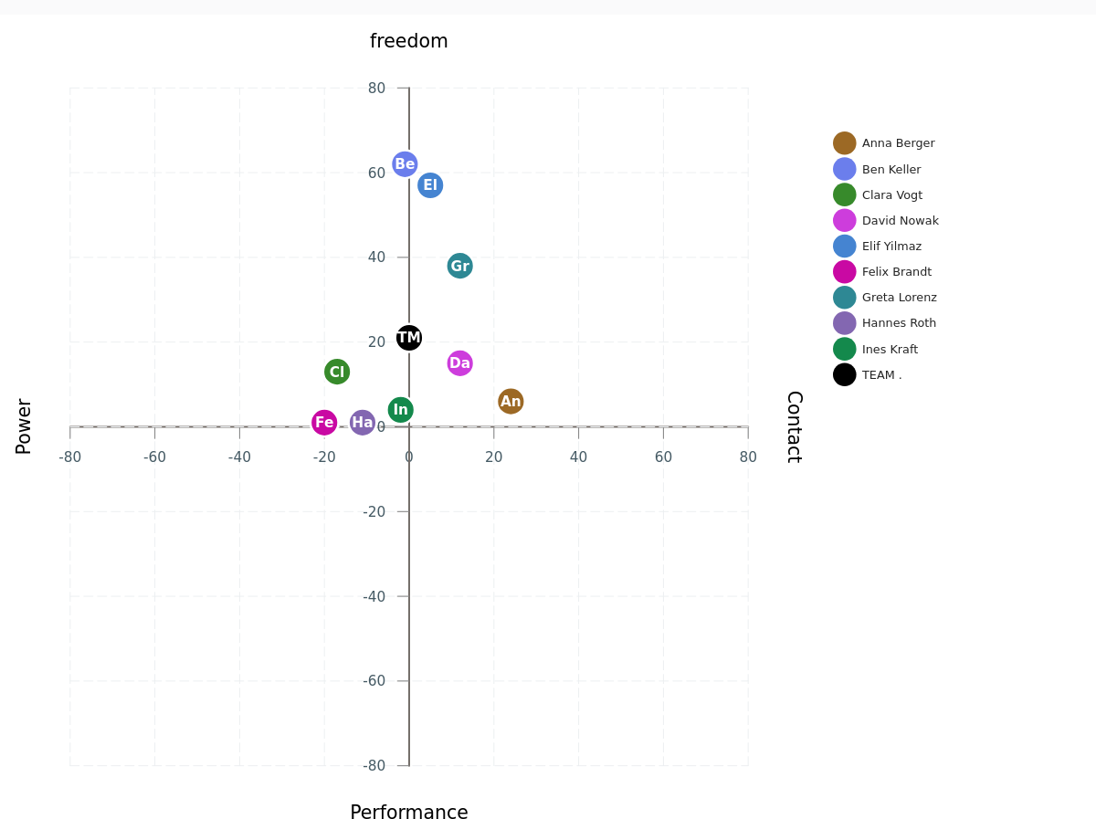
The implicit motives (driving forces)
Team motivation profile
<Foliennummer>
Notes:
Top right = meaningful goals: We want to achieve something together that makes sense in terms of humanistic values.
Bottom-right = rational goals: Team members in this quadrant are more focused on changing facts. What needs to be optimized so that we can achieve our goals?
Bottom-left = correct workflows: Once we agree on the goals, we can focus on the processes. What needs to be done so that we make progress as planned? This is the question that drives people in this area.
Top-left = meaningful workflows: There are usually several process variants available for achieving goals. This is the field for people who prefer to focus on the question of meaningful paths.
Center = balanced management: The alignment of goals and processes, of meaning and facts is the focus of members in the middle of this graphic.

Slide 14
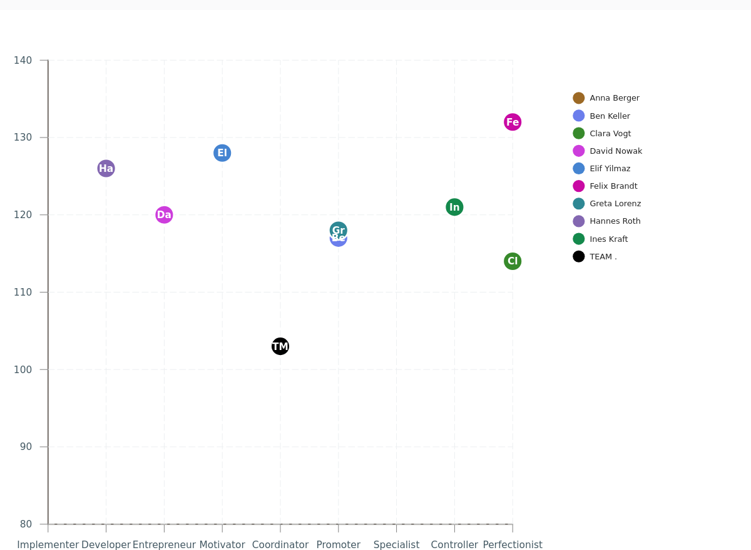
The ideal role assignment
Team motivation profile
<Foliennummer>
Notes:
Realizers: make the team's ideas work. They develop well thought-out strategies and implement them powerfully in practice.
Developers: like unsolved problems, because then they can contribute innovative services to the success of the team.
Entrepreneurs: want to achieve their goals with energy and inventiveness. They want to realize their visions.
Motivator: inspire their colleagues with common goals and measures. They can also sell the team's ideas.
Coordinator: These team members ensure that the tasks that lead to good quality results are carried out in a well-coordinated manner within the team.
Supporters: help individual colleagues in the team with empathy and communication skills. They like to provide emotional support for the team.
Specialist: They like to take responsibility for technical or factual details as part of a team. They want everything to be properly secured.
Controllers: need and ensure order. They are guided by facts and figures in their search for reliability.
Perfectionist: Quality-oriented people also want to be proud of the team's achievements. They therefore strive for perfect results.

Slide 15
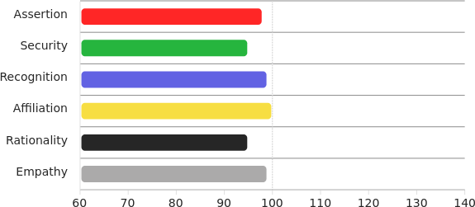
The team personality
Generalist
Team motivation profile
<Foliennummer>
Notes:
The basic needs also apply to the team's internal and external impact:
Red: asserting yourself in order to achieve something,
Yellow: to ensure belonging in order to be there,
Green: pay attention to safety in order to avoid hazards,
Blue: to be recognized, to be worth something,
Black: to recognize reality in order to be able to act meaningfully, and
White: to empathize in order to act responsibly.

Slide 16

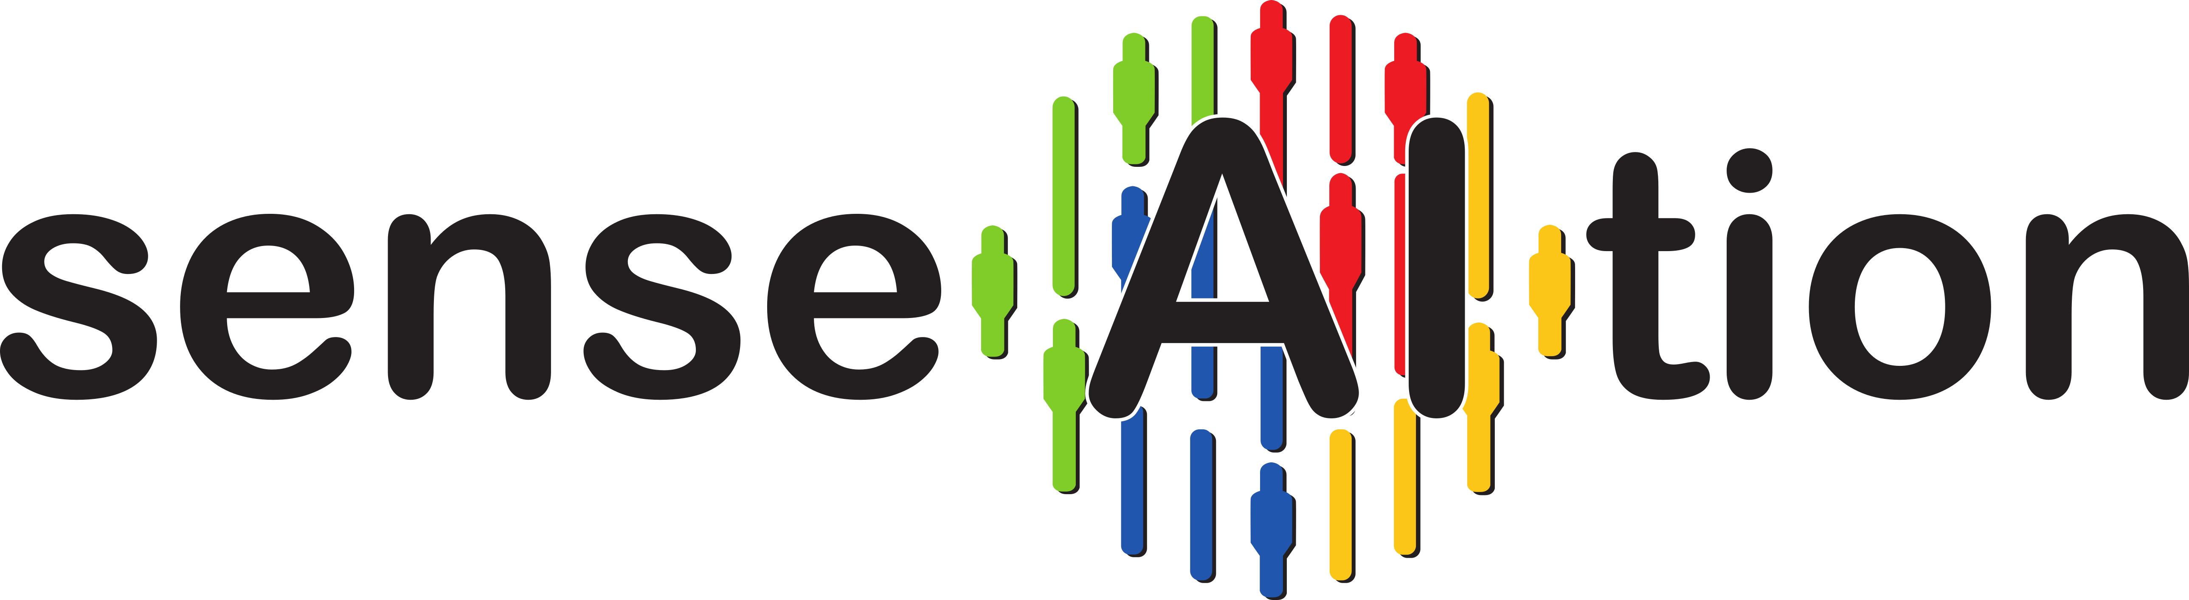
sense.AI.tion
For further information, please contact:
Hamster Handels GmbH
Generated with MatchLytics by:
sense.AI.tion GmbH
Schmiedestraße 2a
15745 Wildau
Germany
https://senseaition.com/
Team motivation profile
<Foliennummer>
Notes:
{{notes17}}

